Slide 1
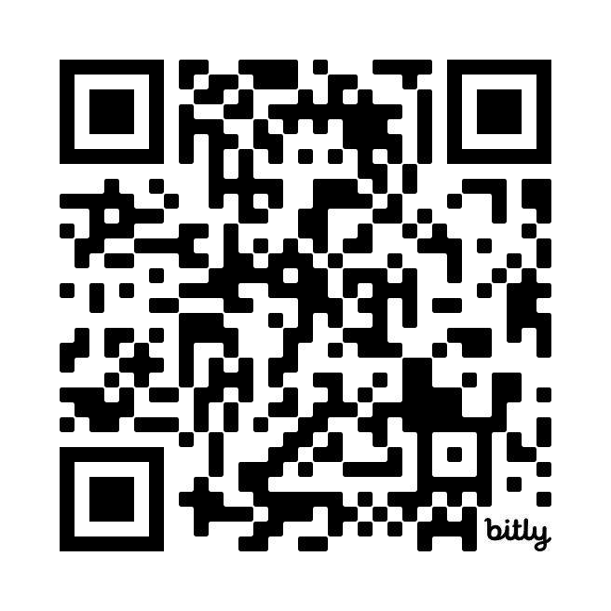
AI Revolution
NOTE: Have phones ready! QR Codes throughout!
45+ Game-Changing Uses for Transforming Association Professional Development
Josh Yavelberg, PhD
Chief Solution Architect
Flying Cloud Solutions

Slide 2
Previous Experience Bingo
crowd.live/PREAI

Slide 3
Session Term Bingo
crowd.live/FCSAI

Slide 4
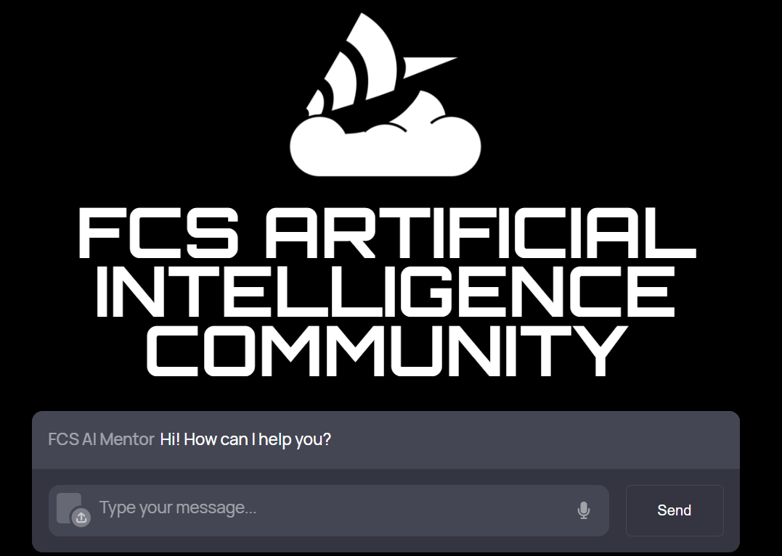
Notes:
Welcome to the FCS Artificial Intelligence Community of Practice, where AI enthusiasts, professionals, and organizations come together to drive innovation. Our mission is to empower associations, non-profits, and educational institutions by leveraging AI for professional development, training, and business management. Here, collaboration is key—our members create and share content, participate in gamified challenges, and contribute to shaping the future of AI. Join us to engage, learn, and make a real impact with AI.

Slide 5
Current Landscape
Disruptive Technology
#1 rule: AI is a tool!
Importance of Agile
Shift from Knowledge to Skills
Ongoing ethical concerns
Notes:
The AI landscape is reshaping industries by accelerating automation, enhancing decision-making, and creating new business models. It's crucial to focus on because it's transforming how organizations operate, innovate, and compete. AI's impact spans from streamlining operations with machine learning and predictive analytics, to personalizing customer experiences using natural language processing and computer vision. Its versatility enables businesses to optimize processes, reduce costs, and uncover insights that drive growth. Focusing on AI's disruptive implications is vital because it helps organizations stay competitive and adapt to the rapidly changing technological landscape. It enables them to seize new opportunities, mitigate risks, and navigate the ethical considerations that come with AI adoption. By understanding and leveraging AI's transformative potential, businesses can thrive in the evolving digital era.
AI is being used in healthcare, where AI is used to personalize treatment plans and predict patient outcomes, improving care delivery. In finance, AI-driven algorithms optimize investment strategies and detect fraudulent transactions, increasing efficiency and security. In manufacturing, AI enhances quality control and predictive maintenance, reducing downtime and costs.
Leveraging AI sounds soulless and as if it will remove jobs in our industry, however, we must be sure to embrace it as a tool. This is my personal #1 rule. The AI algorithms provide a strong tool for augmenting practices that are essentially system 1 thinking to reference Khaneman and the solution provides up to even 80% completion for some tasks, but not without an incredible amount of work still from humans to push it to the right direction, to validate results, and to provide real polish to the products produced. This, however, still represents a huge advantage in terms of costs and implications for how we can shift work and focus.
Shifts:
Traditional waterfall project management processes v. Agile and human-centered design.
Shift away from knowledge to skills-based economy and professional development
Ongoing ethical concerns: Also to reference Khaneman, Algorithms are better and more consistent in decision making within “noisy” spaces, but we still feel icky about giving control of our realities over to math in this way. AI is cold and will be biased toward its math and how it is trained, so we need to be actively aware of these aspects as we integrate it into our practices.

Slide 6
AI For Professional Development Business Management: Member Engagement
AI-Driven CRM Systems
Predictive Analytics for Member Retention
Personalized Member Communication and Customer Service Bots
Automated Personalized Membership Renewals
AI-Powered Surveys and Feedback Collection
Behavioral Analysis for Member Segmentation
Notes:
Slide Title: Membership Engagement
Speaker Notes:
AI-driven CRM Systems (e.g., Salesforce with AI)
Script: "Managing member relationships effectively is at the heart of every association. With AI-driven CRM systems like Salesforce with AI, we can automate member management and engagement tracking. This means the system can automatically log interactions, track member activity, and even predict which members might need more attention, all without requiring manual data entry. By leveraging AI, we can focus more on building genuine relationships rather than being bogged down by administrative tasks."
Predictive Analytics for Member Retention (e.g., Association Analytics)
Script: “Retention is a critical issue for associations, and losing members can have significant impacts on both revenue and community health. AI tools can help by identifying members at risk of leaving. These predictive analytics work by analyzing patterns in member behavior, such as declining event participation or delayed renewals, allowing us to intervene proactively with targeted outreach and personalized offers."
Personalized Member Communication
Script: "In today’s digital age, one-size-fits-all communication strategies no longer cut it. AI-driven insights enable us to tailor communications based on individual member preferences and behaviors. For example, we can send personalized newsletters, recommend relevant events, or offer resources that align with each member’s interests. This level of personalization not only increases engagement but also fosters a deeper connection between the member and the association."
Automated Membership Renewal Reminders
Script: "Membership renewals are vital for sustaining our association, but the process can be cumbersome if done manually. AI can streamline this by automatically sending out reminders at optimal times, based on each member’s past renewal behavior. These reminders can be personalized and even include incentives for early renewal, helping us maintain a steady and predictable membership base."
AI-Powered Surveys and Feedback Collection
Script: "Understanding our members’ needs and satisfaction levels is crucial, but collecting and analyzing feedback can be resource-intensive. AI-powered tools can automate this process by distributing surveys, analyzing responses, and generating actionable insights. This allows us to respond quickly to member concerns and make data-driven decisions to improve our services and offerings.
Behavioral Analysis for Member Segmentation
Script: "Not all members engage with the association in the same way, and it’s important to recognize these differences. AI can help us perform behavioral analysis, segmenting members into groups based on their engagement patterns allowing for strategic decisions to be made regarding the support of or moves to shift certain behaviors. Whether it’s frequent event attendees, passive content consumers, or advocacy-focused members, AI allows us to tailor our strategies for each segment, ensuring that every member feels valued and engaged in a way that resonates with them and for the association to drive members down intended pathways toward organizational mission outcomes."
Closing Transition: "By incorporating AI into our membership engagement strategies, we not only increase efficiency but also deepen our connection with members, driving both retention and satisfaction while gaining insight into what strategic learning products can be developed to meet their needs. Now, let’s explore how AI can enhance our marketing efforts…"

Slide 7
AI For Professional Development Business Management: Marketing and Outreach
AI Email Campaigns
Social Media Management
Content Personalization
Predictive Lead Scoring
AI-Powered Ad Targeting and SEO Management
Automated Marketing Analytics
Notes:
Slide Title: Marketing
Speaker Notes:
AI Email Campaigns
Script: "Email marketing remains one of the most effective ways to reach your audience, but AI is taking it to the next level. With AI email campaigns, we can automate and personalize each email based on recipient behavior, preferences, and past interactions. This not only improves open and click-through rates but also strengthens engagement by delivering the right message at the right time, tailored to each member’s interests."
Social Media Management
Script: "Managing social media across multiple platforms can be a time-consuming task, but AI tools are making it more manageable and effective. AI-driven social media management platforms can analyze trends, schedule posts, and even respond to comments, all while providing insights into what content resonates most with your audience. By leveraging AI, we can maintain an active and engaging social media presence without the manual workload."
Content Personalization
Script: "Personalization is key to capturing and maintaining your audience’s attention in a crowded digital space. AI helps us deliver personalized content by analyzing user data, behaviors, and preferences. Whether it’s tailoring website content, recommending articles, or customizing newsletters, AI enables us to provide a more relevant and engaging experience that speaks directly to the needs and interests of each individual."
Predictive Lead Scoring
Script: "Identifying high-potential leads is essential for effective marketing, and AI can greatly enhance this process. Predictive lead scoring uses AI to analyze data from multiple sources, assigning scores to leads based on their likelihood to convert. This allows us to prioritize our efforts on the most promising leads, improving conversion rates and ensuring that our resources are used where they will have the greatest impact."
AI-Powered Ad Targeting and SEO Management
Script: "Advertising and SEO are critical components of any marketing strategy, and AI is revolutionizing how we approach them. AI-powered ad targeting allows us to reach the right audience with precision, while AI-driven SEO management ensures that our content ranks well in search engines. By automating and optimizing these processes, AI helps us maximize the effectiveness of our marketing efforts, driving more traffic and generating better results."
Automated Marketing Analytics
Script: "Data is the backbone of effective marketing, but analyzing it manually can be overwhelming. Automated marketing analytics powered by AI provide real-time insights into campaign performance, audience behavior, and market trends. These tools help us quickly identify what’s working and what’s not, enabling us to make data-driven decisions that refine our strategies and improve overall outcomes."
Closing Transition: "By integrating AI into our marketing strategies, we not only enhance efficiency but also create more personalized and impactful experiences for our audience. Next, let's explore how AI can transform our event management processes..."

Slide 8
AI For Professional Development Business Management: Event Management
AI-Powered Event Planning Tools
Intelligent Networking Platforms
Automated Event Promotion
Real-Time Attendee Engagement Analysis
AI-Driven Post-Event Analytics
Virtual Event Management
Abstract Submission Management
Notes:
Slide Title: Event Management
Speaker Notes:
AI-Powered Event Planning Tools
Script: "Planning and organizing events can be a complex task, but AI-powered event planning tools are making it easier than ever. These tools can automate everything from venue selection to scheduling, ensuring that all aspects of the event are seamlessly integrated. By analyzing past events and preferences, AI can suggest optimal dates, formats, and even content to maximize attendee satisfaction and engagement."
Intelligent Networking Platforms
Script: "Networking is one of the key reasons people attend events, and AI can enhance this experience significantly. Intelligent networking platforms use AI to match attendees based on their interests, professional backgrounds, and goals. This means that instead of random encounters, attendees can have meaningful and productive interactions with others who share similar objectives, leading to more successful outcomes from the event."
Automated Event Promotion
Script: "Getting the word out about an event is crucial for its success. AI can take the guesswork out of event promotion by automating and optimizing marketing campaigns. These tools can target the right audience segments with personalized messaging, determine the best channels for promotion, and even adjust strategies in real-time based on engagement data. The result is a more effective and efficient promotional effort that drives higher attendance."
Real-Time Attendee Engagement Analysis
Script: "Understanding how attendees are engaging with your event as it happens is invaluable. AI tools can analyze real-time data from attendee interactions—whether it’s session participation, social media activity, or networking engagement. This allows event organizers to make on-the-fly adjustments, such as highlighting popular sessions or facilitating additional networking opportunities, ensuring that the event meets attendees’ needs. Even less cumbersome to members are products like Zenus AI that uses video surveillance and other means to define member engagement and satisfaction within event spaces."
AI-Driven Post-Event Analytics
Script: "The work doesn’t end when the event is over. AI-driven post-event analytics provide deep insights into what worked and what didn’t. By analyzing feedback, engagement metrics, and other data, these tools can help identify key takeaways and areas for improvement. This information is crucial for planning future events and ensuring they continue to evolve and meet the needs of your audience."
Virtual Event Management
Script: "Virtual events have become an essential part of the event landscape, and AI is playing a key role in managing these experiences. AI can help create more interactive and engaging virtual environments, facilitate real-time translation and transcription, and provide personalized content recommendations to attendees. By leveraging AI, virtual events can offer a seamless and enriched experience that rivals in-person gatherings."
Closing Transition: "By integrating AI into every aspect of event management, from planning to post-event analysis, we can create more engaging, efficient, and successful events. Now, let's look at how AI can further enhance our strategic planning and administrative functions...

Slide 9
AI For Professional Development Business Management: Administrative Automation and Strategic Planning
Automated Scheduling and Calendar Management
AI-Driven Financial Reporting
Intelligent Document Management
Predictive Market Analysis
Scenario Planning with AI Simulations
Automated Compliance Monitoring
AI Assisted Certification Processes
Notes:
Slide Title: Administrative Automation and Strategic Planning Support
Speaker Notes:
Automated Scheduling and Calendar Management
Script: "Time management is a challenge for any busy professional, and associations are no exception. AI-powered tools can automate scheduling and calendar management, making it easy to coordinate meetings, events, and deadlines without the usual back-and-forth. These systems can suggest optimal meeting times, send reminders, and even adjust schedules dynamically based on availability and priorities, freeing up time for more strategic activities."
AI-Driven Financial Reporting
Script: "Accurate financial reporting is essential for strategic decision-making. AI tools can automate the creation of financial reports, pulling data from multiple sources, analyzing trends, and even providing predictive insights on budgeting and forecasting. This not only reduces the risk of human error but also enables quicker, more informed financial decisions that align with our strategic goals."
Intelligent Document Management
Script: "Managing the vast amount of documents and data generated by an association can be overwhelming. AI-driven document management systems can help by organizing, categorizing, and retrieving documents with ease. Whether it’s contracts, member records, or strategic plans, these systems ensure that important information is always accessible and secure, allowing us to focus on higher-level strategic tasks."
Predictive Market Analysis
Script: "In an ever-changing landscape, staying ahead of industry trends is crucial. AI can assist in predictive market analysis by identifying emerging trends, potential opportunities, and threats. By analyzing data from various sources, AI provides strategic insights that help us adapt our strategies, align with market demands, and position our association for future success."
Scenario Planning with AI Simulations
Script: "Strategic planning often involves considering various scenarios and their potential impacts. AI-driven simulations allow us to test different strategies in a risk-free environment, exploring 'what if' scenarios to see how different decisions might play out. This helps us make more informed, data-driven choices that are resilient to uncertainties."
Automated Compliance Monitoring
Script: "Compliance with regulations and standards is non-negotiable for any association. AI can automate compliance monitoring by continuously checking our processes and systems against the latest regulations. This proactive approach not only reduces the risk of non-compliance but also frees up resources that can be redirected toward strategic initiatives."
Closing Transition: "Integrating AI into both our administrative operations and strategic planning not only increases efficiency but also equips us with the insights needed to make proactive, informed decisions.

Slide 10
Half-time Show: Cards Against AI
crowd.live/CARDS

Slide 11
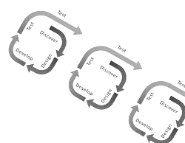
AI For Learning Experience Development: Agile Learning Design and Development
AI-Driven Content Creation Tools
Adaptive Learning Pathways
Prototyping with AI
AI-Powered Content Curation
Agile Project Management Tools
Collaborative AI Platforms
Notes:
Slide Title: AI for Learning Experience Development: Agile Learning Design and Development
Speaker Notes:
AI-Driven Content Creation Tools
Script: "To begin with, AI-driven content creation tools are revolutionizing the way we develop learning materials. These tools can generate text, video, and interactive elements rapidly, allowing instructional designers to create content at unprecedented speed. This agility is essential for producing Minimum Viable Products, or MVPs, that can be quickly iterated based on user feedback, ensuring that resources are strategically invested in the most effective solutions."
Adaptive Learning Pathways
Script: "Next, we have adaptive learning pathways. These AI-powered systems dynamically adjust the learning experience based on the learner’s performance and preferences. This ensures that each learner follows a path that is most suited to their individual needs, enhancing both engagement and effectiveness. By focusing on skills rather than just knowledge, adaptive learning helps build competencies that are directly applicable in real-world situations."
Prototyping with AI
Script: "Prototyping is another area where AI can make a significant impact. With AI, we can rapidly create prototypes of learning modules, which can be tested and refined in real-time. This iterative process aligns perfectly with Agile practices, allowing us to continuously improve the learning experience based on actual learner interactions and feedback."
AI-Powered Content Curation
Script: "AI-powered content curation tools help us ensure that the learning materials we provide are not only relevant but also up-to-date and engaging. These tools can sift through vast amounts of content, recommend the most pertinent resources, and even suggest new content areas that align with current learner needs and industry trends. This curation is crucial for maintaining the quality and relevance of our learning experiences."
Agile Project Management Tools
Script: "Agile project management tools enhanced with AI are key to maintaining the momentum of learning development projects. These tools help us track progress, manage tasks, and adapt to changing requirements in real-time. By integrating AI, these platforms can predict potential bottlenecks, suggest adjustments, and optimize workflows to keep projects on track and aligned with strategic goals."
Collaborative AI Platforms
Script: "Finally, collaborative AI platforms are transforming how instructional designers, subject matter experts, and other stakeholders work together. These platforms use AI to facilitate communication, manage version control, and ensure that all contributors are aligned in their efforts. This collaboration is critical in creating learning experiences that are not only high-quality but also reflective of diverse perspectives and expertise."
Closing Transition: "By incorporating these AI-driven tools and practices into our learning experience development, we can shift from a traditional knowledge-based approach to a more dynamic, skills-focused model that is both agile and learner-centered. Next, we’ll explore how AI can enhance skills-based learning and assessment..."

Slide 12
AI For Learning Experience Development: Skills-Based Learning
Competency Mapping with AI
AI-Powered Microlearning Modules
AI-Driven Skill Assessment Tools
Scenario-Based Learning with AI Simulations
AI-Enhanced Peer Learning
Skill Gap Analysis
Notes:
Slide Title: AI for Learning Experience Development: Skills-Based Learning
Speaker Notes:
Competency Mapping with AI
Script: "We start with competency mapping, a crucial first step in skills-based learning. AI can help us identify the specific competencies required for different roles and align our learning programs accordingly. By analyzing job descriptions, performance data, and industry trends, AI provides a clear map of the skills that learners need to develop, ensuring that our training is directly relevant to their job roles and future career paths."
AI-Powered Microlearning Modules
Script: "Next, AI-powered microlearning modules are designed to deliver content in small, manageable chunks, which are ideal for building specific skills. These modules are personalized to the learner’s needs and can be consumed on-demand, making them perfect for busy professionals who need to fit learning into their schedules. The bite-sized nature of microlearning also enhances retention, allowing learners to quickly apply what they’ve learned in their day-to-day tasks."
AI-Driven Skill Assessment Tools
Script: "Assessment is key to understanding how well learners are acquiring the necessary skills. AI-driven skill assessment tools provide a more accurate and efficient way to evaluate learners’ abilities. These tools can offer instant feedback, identify areas where learners need improvement, and even suggest personalized learning paths to address skill gaps. This real-time assessment capability is crucial for ensuring that learners are progressing effectively."
Scenario-Based Learning with AI Simulations
Script: "Scenario-based learning with AI simulations takes skill development to the next level. These simulations place learners in realistic scenarios where they must apply their skills to solve problems. By mimicking real-world challenges, AI simulations allow learners to practice and refine their skills in a safe environment, providing them with the confidence and competence to tackle similar situations in their actual work."
AI-Enhanced Peer Learning
Script: "Peer learning is another powerful approach to skills development, and AI can enhance this process by facilitating connections between learners with complementary skills and knowledge. AI-moderated discussion forums and group projects encourage collaboration, enabling learners to learn from each other’s experiences and perspectives. This not only reinforces the skills being taught but also fosters a collaborative learning culture."
Skill Gap Analysis
Script: "Finally, skill gap analysis is essential for identifying areas where learners or the organization as a whole may be lacking in critical skills. AI can analyze data across various metrics to pinpoint these gaps, allowing us to design targeted interventions that address specific needs. By continuously monitoring and analyzing skill gaps, we can ensure that our learning programs remain relevant and effective in a rapidly changing environment."
Closing Transition: "By integrating AI into skills-based learning, we can create more personalized, relevant, and effective training programs that not only meet the needs of learners but also align with organizational goals. Next, we’ll explore how AI can streamline assessment creation and evaluation, ensuring that we accurately measure and support learner progress..."

Slide 13
AI For Learning Experience Development: Assessments and Evaluations
Automated Test Question Generation
AI-Powered Adaptive Testing
Real-Time Assessment Feedback
Intelligent Gradebooks
AI-Driven Rubric Creation
Automated Essay Scoring
Notes:
Slide Title: AI for Learning Experience Development: Assessments and Evaluations
Speaker Notes:
Automated Test Question Generation
Script: "We start with automated test question generation. AI can quickly generate a wide range of assessment questions, from multiple-choice to open-ended, all aligned with specific learning objectives. This not only saves time for educators and instructional designers but also ensures that assessments are comprehensive and tailored to the skills being developed."
AI-Powered Adaptive Testing
Script: "Next is AI-powered adaptive testing, a game-changer in personalized assessments. These systems adjust the difficulty of questions based on the learner’s previous responses, providing a more accurate measure of their abilities. This type of testing adapts in real-time to challenge learners appropriately, ensuring they are neither bored nor overwhelmed."
Real-Time Assessment Feedback
Script: "Real-time assessment feedback is crucial for effective learning. AI enables us to provide immediate, detailed feedback on assessments, helping learners understand their strengths and areas for improvement as they progress. This instant feedback loop accelerates the learning process and helps maintain engagement by addressing issues as they arise."
Intelligent Gradebooks
Script: "Intelligent gradebooks go beyond simply recording grades. They use AI to track and analyze learner progress over time, providing insights into trends and identifying areas where additional support might be needed. These gradebooks can automatically update with new data, reducing administrative work and ensuring that records are always accurate and up to date."
AI-Driven Rubric Creation
Script: "Rubrics are essential for consistent and fair grading, especially in subjective assessments like essays or projects. AI-driven rubric creation tools can generate rubrics tailored to specific assignments, ensuring that all aspects of the task are evaluated according to clear, objective criteria. This helps maintain fairness and transparency in the evaluation process."
Automated Essay Scoring
Script: "Finally, automated essay scoring is transforming how we assess written work. AI can evaluate essays not just for grammar and spelling but also for content, coherence, and adherence to the assignment guidelines. This allows for faster turnaround times on grading, providing learners with timely feedback that helps them improve their writing skills."
Closing Transition: "By integrating AI into our assessment and evaluation processes, we can create more personalized, accurate, and efficient systems that truly support learner development. Next, we'll dive into how AI can enhance content development solutions, ensuring that our learning experiences are engaging, accessible, and effective..."

Slide 14
AI For Learning Experience Development: Content Development
Gamification
Generative Text and Multimedia
Code Generation
Human-Centered Design (HCD) Artifact Creation
Chat Bots and Custom GPTs
Presentation and Artifact Development
Interactive Video Creation
Notes:
Slide Title: AI for Learning Experience Development: Content Development
Speaker Notes:
Gamification
Script: "We start with gamification, a powerful tool for increasing learner engagement. AI can help us design and implement game-like elements in our content, such as points, badges, and leaderboards, to motivate learners and make the learning experience more interactive and fun. By leveraging AI, we can personalize these elements to align with individual learning styles and goals, ensuring that gamification is not just entertaining but also effective in promoting deep learning."
Generative Text and Multimedia
Script: "Generative AI is transforming how we create content. With AI, we can generate text, images, videos, and other multimedia elements that are not only high-quality but also tailored to specific learning objectives. This capability allows us to quickly develop diverse and engaging content, ensuring that our learning materials are both comprehensive and aligned with the needs of our learners."
Code Generation
Script: "For technical learning programs, AI-powered code generation can be a game-changer. These tools can automatically generate code snippets or even entire programs based on natural language descriptions or specific instructions. This not only speeds up the content creation process for coding courses but also helps learners see practical applications of their learning in real-time, reinforcing their understanding of programming concepts."
Human-Centered Design (HCD) Artifact Creation
Script: "AI can also support the creation of Human-Centered Design artifacts, such as personas, journey maps, and prototypes. These artifacts help us better understand our learners’ needs and design learning experiences that are tailored to those needs. By using AI to automate the creation of these artifacts, we can ensure that our design process is both efficient and deeply informed by user data."
Chat Bots and Custom GPTs
Script: "AI-powered chatbots and custom GPTs are transforming learner support. These tools can provide real-time assistance, answering questions, offering resources, and guiding learners through complex topics. By integrating chatbots into our learning platforms, we can offer personalized support at scale, ensuring that every learner has access to the help they need when they need it."
Presentation and Artifact Development
Script: "Creating presentations and other learning artifacts can be time-consuming, but AI tools can automate much of this process. From generating slide decks to developing infographics and reports, AI ensures that our presentations are both visually appealing and content-rich, allowing us to focus on delivering the best possible learning experience."
Interactive Video Creation
Script: "Finally, interactive video creation is a powerful way to engage learners. AI can help us create videos where learners make decisions, explore different scenarios, and interact with the content in real-time. This not only makes the learning experience more engaging but also allows learners to practice decision-making and problem-solving in a safe, controlled environment."
Closing Transition: "By incorporating AI into our content development processes, we can create more engaging, accessible, and effective learning materials. These tools not only streamline the content creation process but also ensure that our learning experiences are tailored to meet the diverse needs of our learners. Next, let’s review how we can apply these concepts to ensure continuous improvement in our learning strategies..."

Slide 15
AI For Learning Experience Development: Content Accessibility
Knowledge Assistant Chatbots
AI Taxonomy Management
ADA Compliance Assessments
Live Closed Captioning (Thank You Wordly!)
Language Translation
Content Translation
Notes:
Slide Title: AI for Learning Experience Development: Content Accessibility
Speaker Notes:
"Next, let's talk about how AI is enhancing content accessibility within Learning Experience Development. Here are five critical areas where AI is making a significant difference:
Knowledge Assistant Chatbots – AI-powered chatbots are providing real-time, on-demand assistance to learners, making information more accessible and support more immediate.
AI Taxonomy Management – AI is helping to organize and manage content by automatically tagging, categorizing, and structuring it, ensuring that learners can easily find what they need.
ADA Compliance Assessments – AI tools are being used to assess and ensure that content meets ADA compliance standards, making learning materials accessible to everyone, including those with disabilities.
Live Closed Captioning – AI-driven closed captioning services have evolved rapidly in the past several years. Several years ago this service was still best done manually and cost around $100 / hour for our association webinars. Now, for a fraction of that cost, you can include live captions into live and virtual events to assure your content is accessible.
Language Translation – AI-driven language translation is breaking down barriers, enabling content to be easily translated into multiple languages, making learning more inclusive on a global scale.
Content Translation – Beyond language, AI is helping to translate complex ideas and concepts into more digestible forms, ensuring that content is accessible to learners of all backgrounds and knowledge levels.
By leveraging these AI-driven tools, we can create learning experiences that are not just effective but also accessible to all, ensuring that everyone has the opportunity to learn and grow."

Slide 16
Balancing Innovation with Ethics: Discussion
Some Possible Topics…
Data Privacy
Bias Detection
Transparency and Documentation
Notes:
Possible Discussion Topics:
Data Privacy
AI Tools for Data Anonymization (e.g., Privitar): Ensuring that personal data used in AI applications is anonymized to protect individuals' privacy.
Compliance Monitoring (e.g., OneTrust): Monitoring and ensuring compliance with data protection regulations, such as GDPR, using AI-driven tools.
Bias Detection
AI Fairness Auditing Tools (e.g., Fairlearn): Tools that assess AI systems for biases, ensuring that decisions made by AI are fair and unbiased.
Diversity and Inclusion Analytics (e.g., Diversio): Using AI to analyze and promote diversity and inclusion within organizations.
Transparency
Explainable AI Tools (e.g., LIME): Ensuring that AI decision-making processes are transparent and understandable to users, helping build trust in AI systems.
Transparent AI Reporting (e.g., Model Cards for AI): Creating clear and transparent documentation for AI models, including their capabilities, limitations, and the data they were trained on.

Slide 17
Session Term Bingo Results and Action Items
Action Items
Term Bingo Winner?
Join our community: flyingcloudsolutions.com/ai
Use AI as a tool!
Embrace disruption ethically
Develop a skills-based learning economy
Adopt an Agile management framework
Develop a data strategy. Garbage data in = Garbage AI outputs
Use data to make learner-centered decisions
Let AI handle routine and administrative tasks so you can focus on strategic thinking and operations

Slide 18
Josh Yavelberg, PhD
Chief Solutions Architect
Flying Cloud Solutions
FlyingCloudSolutions.com

Slide 19
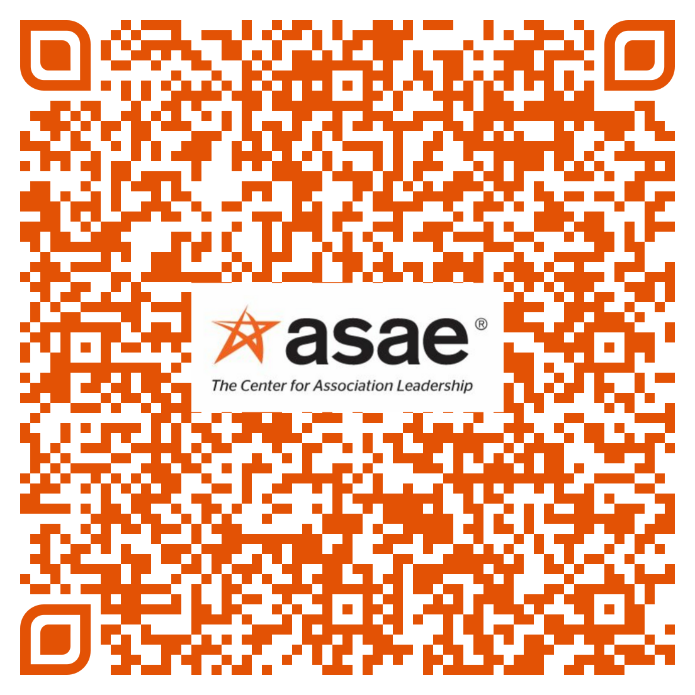
Complete Your Session Evaluation

